Slide 1

PROJECT ENTITLED
“CHESS GAME”
Submitted in partial fulfillment of the requirements for the award of a degree of
BACHELOR ENGINEERING
of
COMPUTER SCIENCE AND ENGINEERING
For the Academic Year 2022-23
Submitted by:
Amulya 1MJ20CS021
Under the Guidance of
Mr Vinay Raj A S
Assistant Professor, Department of CSE
MVJ College of Engineering, Bangalore
Approved by AICTE |Affiliated to VTU | Recognized by UGC with 2(f) & 12(B) status |Accredited by NBA and NAAC

Slide 2
CONTENTS
Abstract
Introduction
Problem Statement
Existing System
Proposed System
Implementation
Working
Hardware & Software Requirements
Applications
Future Scope
Conclusion

Slide 3
ABSTRACT
The Online Chess Game project is a web-based platform that allows chess enthusiasts to play the game against each other over the internet. The project's primary objective is to provide a user-friendly and seamless experience for players to connect with each other from different parts of the world
The project's development involves various stages, including designing the user interface, developing the game's core functionality, integrating various features like multiplayer mode, leaderboards, and chat rooms, and testing the platform for bugs and errors.
The project aims to attract chess enthusiasts from different parts of the world and build a thriving community of players. The platform's success will be measured by the number of active users, positive feedback from players, and participation in organized tournaments and events. Overall, the Online Chess Game project aims to provide an accessible and enjoyable chess-playing experience to players of all skill levels.
Approved by AICTE |Affiliated to VTU | Recognized by UGC with 2(f) & 12(B) status |Accredited by NBA and NAAC

Slide 4
PROBLEM STATEMENT
Design and develop an online chess game platform that allows players to play against opponents from around the world in real time. The platform should provide a user-friendly interface, advanced gameplay features, and a robust backend system. Chess is a highly strategic game that requires players to think ahead, plan their moves, and anticipate their opponent's actions. It develops critical thinking skills, logical reasoning, and the ability to analyze complex situations. Chess presents players with a series of challenges that need to be overcome through creative problem-solving. Players must assess the board, identify patterns, and find the best solutions to achieve their objectives. Chess demands concentration and focus as players need to pay attention to the board and the changing dynamics of the game. It helps improve mental discipline, attention span, and the ability to stay focused for extended periods.
Approved by AICTE |Affiliated to VTU | Recognized by UGC with 2(f) & 12(B) status |Accredited by NBA and NAAC

Slide 5
INTRODUCTION
Online chess games have revolutionized the way people play and experience the game of chess. With the advancement of technology and the widespread availability of internet access, players can now engage in thrilling chess matches with opponents from all corners of the globe, breaking down geographical barriers and creating a vibrant and interconnected chess community. The game provides a digital platform where players can enjoy the intellectual challenge, strategic depth, and competitive spirit of the game without the need for physical chess sets or the constraints of playing in person. It combines the timeless appeal of chess with the convenience, accessibility, and interactivity offered by online platforms.
Approved by AICTE |Affiliated to VTU | Recognized by UGC with 2(f) & 12(B) status |Accredited by NBA and NAAC

Slide 6
EXISTING SYSTEM
Disadvantages of the existing system :
Some existing chess game systems lack real-time interaction between players. Asynchronous gameplay, where players take turns at their convenience, may diminish the excitement and engagement of live chess matches.
Players can use chess engine software or receive assistance from computer programs during matches, which undermines the fairness and integrity of the game.
Many online chess games primarily focus on standard chess variants and may lack support for a wide range of chess variants. This can limit the variety and diversity of gameplay options available to players.

Slide 7
PROPOSED SYSTEM
User-friendly and visually appealing interface for smooth navigation and gameplay.
Interactive chessboard with intuitive controls for easy piece movement and interaction.
Clear visual indicators for legal moves, highlighting available squares and potential captures.
Smooth synchronization of moves to ensure a consistent game state for all players.
Time controls to manage the duration of each player's turn and prevent excessive delays.
Approved by AICTE |Affiliated to VTU | Recognized by UGC with 2(f) & 12(B) status |Accredited by NBA and NAAC

Slide 8
HARDWARE & SOFTWARE REQUIRED
The following requirements are required for the implementation of the project:
HARDWARE REQUIREMENTS
computer with the latest requirements
Hard Disk : 120 GB
Monitor : 12” LED
Input devices : Keyboard, Mouse
RAM : 4GB
2. SOFTWARE REQUIREMENTS
Operating System : Windows 11, 64-bits Operating System
Coding Language : HTML , CSS , JAVASCRIPT
Software Tool : Brackets
Approved by AICTE |Affiliated to VTU | Recognized by UGC with 2(f) & 12(B) status |Accredited by NBA and NAAC

Slide 9
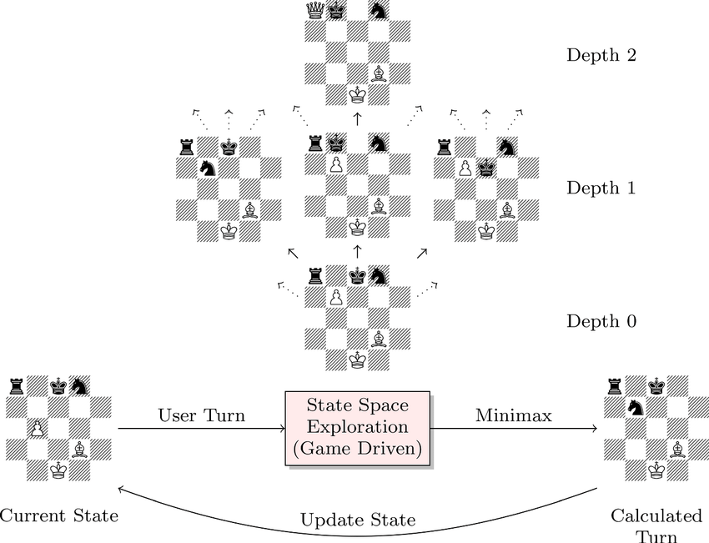
IMPLEMENTATION
The below diagram shows the system architecture of the project for the easier visualization of the implementation.
Approved by AICTE |Affiliated to VTU | Recognized by UGC with 2(f) & 12(B) status |Accredited by NBA and NAAC

Slide 10
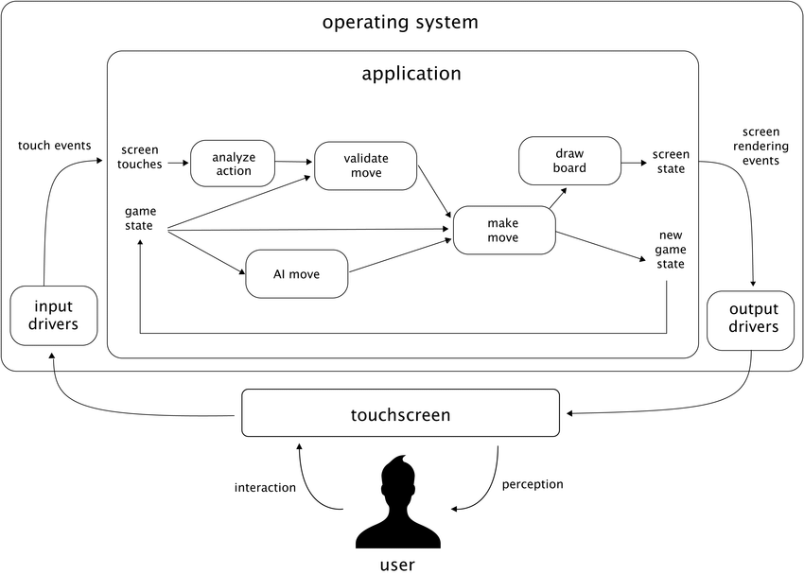
WORKING
The below diagram shows the system flow of the project for easier understanding and visualization of the above content.
Approved by AICTE |Affiliated to VTU | Recognized by UGC with 2(f) & 12(B) status |Accredited by NBA and NAAC

Slide 11
ADVANTAGES
Advantages of the proposed system are
Chess is a highly strategic and complex game that engages the mind. Regularly playing chess can improve critical thinking, problem-solving, and analytical skills. It requires players to anticipate moves, plan ahead, and consider various possibilities, stimulating the brain and enhancing cognitive abilities.
involves remembering and recalling various positions, strategies, and patterns. The game challenges players to remember past moves, anticipate future moves, and recognize patterns on the board. Regular chess practice can improve memory retention and recall abilities.
Chess helps develop strategic thinking, foresight, and the ability to make calculated moves
Players can continuously learn and improve their skills, making chess a lifelong pursuit of knowledge and self-improvement.
Approved by AICTE |Affiliated to VTU | Recognized by UGC with 2(f) & 12(B) status |Accredited by NBA and NAAC

Slide 12
APPLICATIONS
Players can participate in online tournaments, leagues, and rankings to showcase their abilities and compete for prizes.
Online chess games serve as valuable educational tools for learning and training in chess. They offer tutorials, puzzles, and interactive lessons to help beginners understand the game's rules and strategies
Players can receive coaching from experienced chess players and instructors via online platforms, receiving personalized guidance and feedback on their gameplay. This allows for flexible learning schedules and access to a wide range of coaches worldwide.
The availability of large-scale player data and gameplay statistics allows researchers to analyze and improve AI algorithms for chess. Online platforms also serve as environments for AI vs. AI matches and algorithm competitions.
They allow players to explore various chess variants, including traditional and regional variations, thus fostering appreciation for the rich heritage of the game.
Approved by AICTE |Affiliated to VTU | Recognized by UGC with 2(f) & 12(B) status |Accredited by NBA and NAAC

Slide 13
FUTURE ASPECT
With advancements in virtual reality technology, we may see the emergence of immersive VR chess experiences. Players could don VR headsets and enter virtual environments where they can interact with a 3D chessboard, move pieces with hand gestures, and even play against AI opponents or other players in realistic virtual settings.
Online chess games may provide more options for personalization, allowing players to customize their chess pieces, boards, and themes. Players may be able to create and share their own chess variants, allowing for unique and creative gameplay experiences.
The integration of blockchain technology could bring benefits such as enhanced security, transparency, and ownership of in-game assets. It could enable the creation and trading of rare or collectable digital chess pieces, as well as the development of decentralized chess platforms that ensure fairness and trust among players.
Approved by AICTE |Affiliated to VTU | Recognized by UGC with 2(f) & 12(B) status |Accredited by NBA and NAAC

Slide 14
CONCLUSION
In conclusion, online chess games have become immensely popular and have revolutionized the way people engage with this ancient game. They offer a range of advantages and benefits, including mental stimulation, strategic thinking, cognitive development, and social interaction. Online chess games provide a platform for competitive gaming, chess education, remote learning, and coaching, as well as analysis and research. They cater to both casual players seeking entertainment and serious players aiming to improve their skills.
The future of online chess games holds even more exciting possibilities, including virtual reality and augmented reality experiences, enhanced AI integration, cross-platform compatibility, advanced spectator features, and the potential for eSports and a competitive chess scene. Personalization, customization, and improved training resources are also expected to enrich the online chess gaming experience. Furthermore, the integration of blockchain technology could introduce new dimensions of security, ownership, and asset trading.
Approved by AICTE |Affiliated to VTU | Recognized by UGC with 2(f) & 12(B) status |Accredited by NBA and NAAC

Slide 15
Thank You

